Slide 1
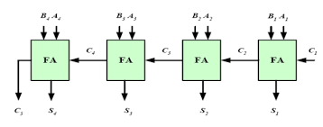
Design and Simulation of a 4-bit binary adder using Verilog HDL

Slide 2
What is 4-bit Binary Adder?
A 4-bit binary adder is that adds two 4-bit binary numbers.
It is made using full adders, where each full adder adds one bit at a time.
The carry output from one full adder is passed to the next full adder, so all bits are added correctly.
This type of adder is also called a ripple-carry adder.
Working:
Four full adders(FA1, FA2, FA3, FA4) are connected in series. Each full adder adds one bit of inputs A(A1, A2, A3, A4) and B(B1, B2, B3, B4). The carry(C1, C2, C3, C4) output from one adder goes to the next adder. Finally, the circuit produces 4 sum(S1, S2, S3, S4) bits and one final carry C5.

Slide 3
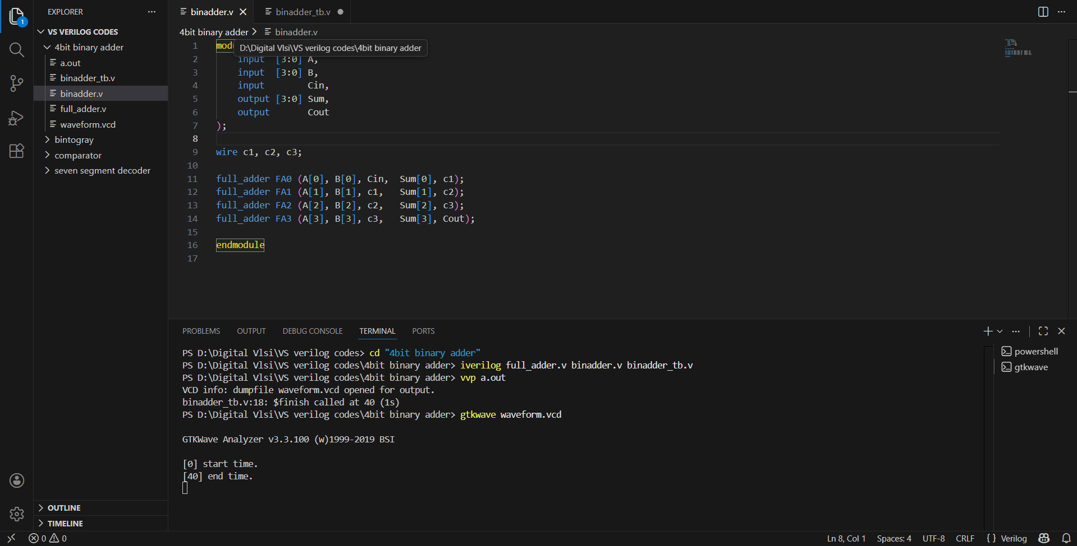
Design

Slide 4
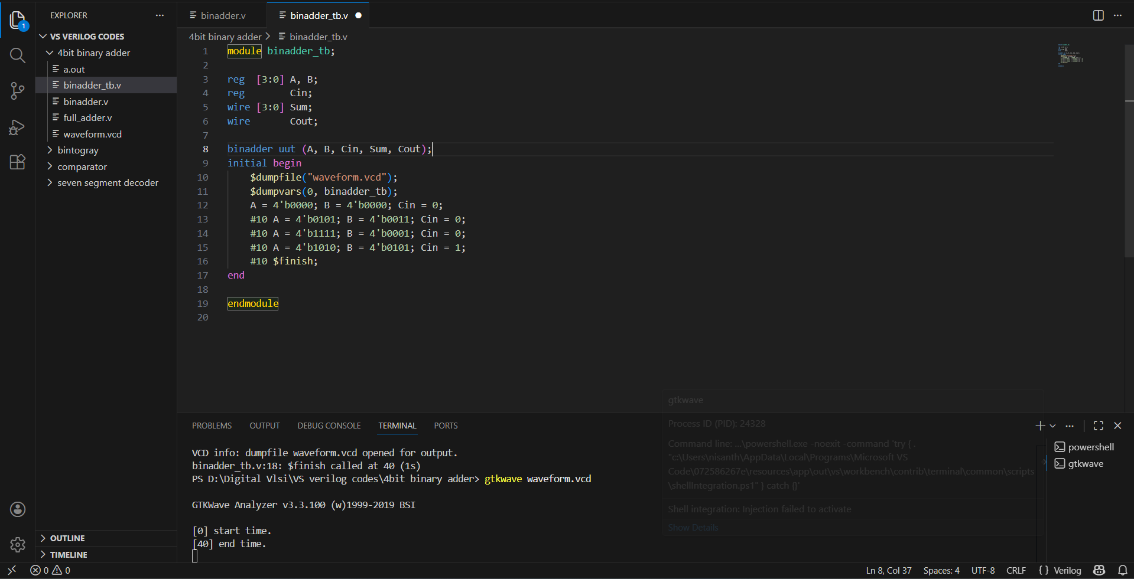
Testbench

Slide 5
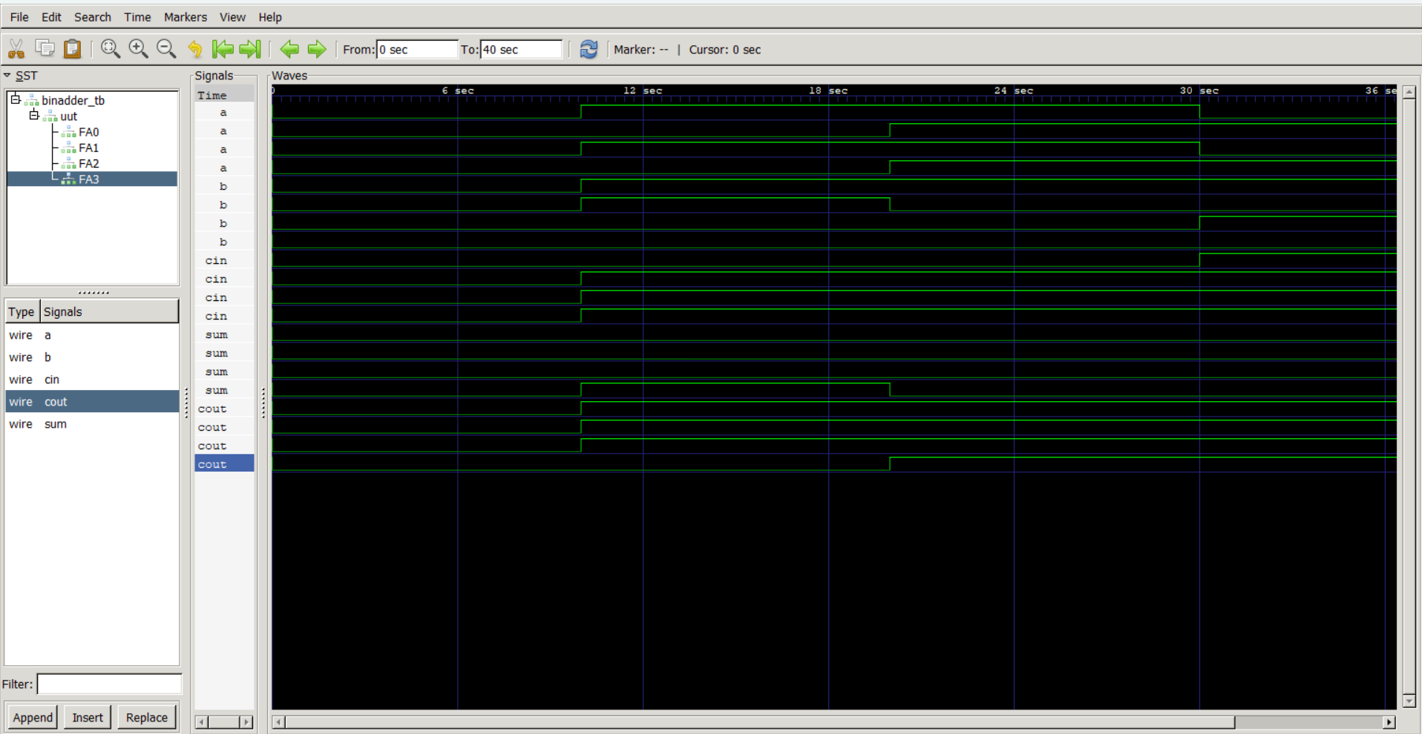
Waveform

